Slide 1
First Break
To establish minimum safety requirements when performing a first break
“First Break” – Refers to the initial opening of piping/equipment that previously contained hazardous materials. i.e. piping in rack for NaOH
Does not apply to connections design to be readily opened. i.e. sampling points.

Slide 2
First Break
This presentation covers pipes –lines- and equipment opening (LEO)
Pipes and equipment may contain:
Corrosives (bleach, caustic, acid)
Toxic (chlorine gas)
Flammable (propane)
Cold Fluid(Liquid N2)
High Pressure(Compressed Air)
Inert Gases(nitrogen)

Slide 3
First Break
A permit is required when opening any pipe
Different responsibilities fall on the Permit Issuer and the Person Conducting Work
Permit Issuer: Facility manager or designee
Assist with line identification, shutdown, isolation, purging etc.
Completes LEO permit
Finishes paperwork after work completed

Slide 4
First Break
Person Conducting Work: Responsible for
Identifying the correct line
Obtaining/signing LEO before starting work
Obtaining proper PPE
Verify line is drained before working
Comply with LEO requirements
Finishes paperwork after work completed

Slide 5
First Break
Worker Reports to equipment owner
Explain Work
Obtains LEO
Proper PPE is obtained and safety showers/ fire extinguishers checked
Equipment owner shuts-down the system
The system is isolated: must meet lockout/tag-out requirements, may sometimes need blinding
Pressure Release: Pressure is bled off in a safe manner
Line is drained/purged/cleaned

Slide 6
First Break
1) Pick the safest location
2) Approach anything as potentially dangerous
3) Ensure line is isolated
4) Loosen farthest bolts first

Slide 7
First Break
Duration: Only lasts as long as the users work shift
Retention: Must be kept for a year

Slide 8
Blind Placement
Purpose
To ensure that personnel, the environment, and equipment are protected from unintended releases of potentially hazardous substances or energy while performing process equipment and piping repair, service or maintenance activities.

Slide 9
Blind Placement
In general, pipes contain substances that could be hazards or at high pressure, or hot, so careful attention should be given while trying to break any line or to enter into any confined space.
All pipes must be disconnected, blanked or blinded off before any Personnel enter the confined space.

Slide 10
Blind Placement
THE CLOSING OF ISOLATION VALVES ON ANY LINE CONTAINING A HAZARDOUS SUBSTANCE IS NOT ACCEPTABLE AS A SUBSTITUTE FOR BLANKING OR BLINDING.

Slide 11
Blind Placement
Lines which have been blanked or blinded shall be clearly marked with a tag to indicate that a blind or blank has been installed. A record of the blinding must be entered in the Blind Placement Log Book by the operator in charge when the blinding procedure occurred.

Slide 12
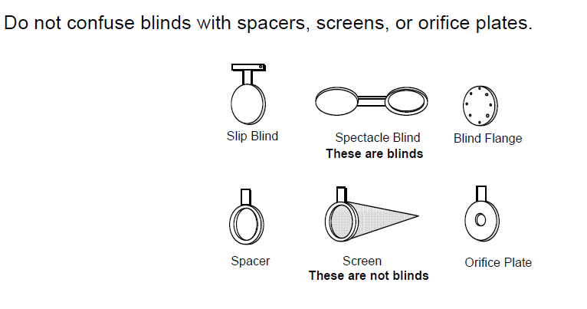
Blind Placement

Slide 13
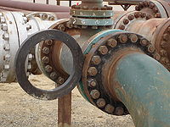
Blind Placement
Spectacle Blind with blind side installed

Slide 14
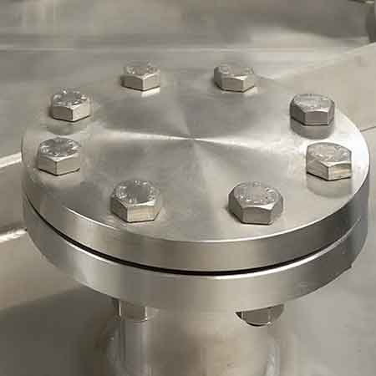
Blind Placement
Blind Flange installed

Slide 15
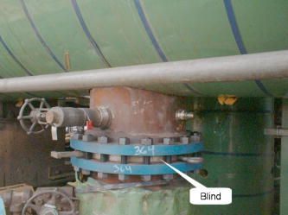
Blind Placement
Slip Blind installed

Slide 16
Blind Placement
Blanks or blinds shall be thick enough to hold the pressure of the line, proper material and installed in a manner to provide adequate safety for the particular conditions of anticipated maximum pressure, temperature, and work to be completed.

Slide 17
Blind Placement
Where it is impractical to blank or blind piping containing hazardous substances, written work procedures must be developed and approved by the Facility Manager and the Safety Committee to ensure at least equal protection to all personnel exposed to the potential hazard.

Slide 18
Blind Placement
On welded joint piping, valves will be acceptable to blanking or blinding providing that:
Block valves in the flow line are LOCKED out in a CLOSED position.
A bleed-off valve and line is located between the closed block valve and the confined space.
This bleed-off valve is LOCKED in the OPEN position.
A worker is stationed at the bleed-off location to monitor and to warn others if an emergency occurs.
There is NO other way to blind the line.

Slide 19
Blind Placement
Welded joint blinding

Slide 20
Blind Placement
Responsibilities
Person in Charge, Lead Operators and Consultants
Must evaluate the process to be isolated with all affected personnel to ensure that all process systems and piping are properly isolated and identified.

