Slide 1
Electrical Equipment
CSP uses conventional electrical equipment in the majority of areas
All installations follow the mandatory electrical codes
The HCl unit end line conduits are considered hazardous and are protected with explosion proof junctions.
CSP receives medium voltage at 13200 V AC from the utility company

Slide 2
Electrical Equipment
The medium voltage feeds the low voltage circuitry of 480 VAC and 120 VAC
It also feeds a circuit breaker, NW of process, in the electrical room intended for the rectifier
When all process interlocks are ready, the breaker is allowed to close and pass this AC voltage to the rectifier “Transformer.”

Slide 3
Electrical Equipment
The transformer steps down the voltage to the specifications of the rectifier of approx 500 volts AC.
The rectifier converts the AC voltage to DC voltage.
The dc voltage passes through two DC isolated switches and on to the Electrolyser.

Slide 4
Electrical Equipment
The amount of total voltage at the Electrolyser is determined by the number of cells installed, temperatures, and aging of membranes.
The actual current to the Electrolyser is controlled by the CR operator and is the determining factor of plant production rates up to 17,000 amperes.
It is safe to walk around the electrolyser during normal operation because it is electrically isolated.

Slide 5
Electrical Equipment
A) No maintenance work is permitted while the electrolyser is in operation
B) Never crawl below Electrolyser in operation.
C) Never leave doors on rectifier open.
D) Must wear di-electric boots while doing maintenance in the cell area.
E) Use caution when using water near the Electrolyser.
F) Avoid electrical contact of a cell and the ground.

Slide 6
Electrical Equipment
G) Brine and caustic leaks in the electrolyser shall be repaired ASAP to reduce the number of paths for current to flow to the ground.
H) During maintenance, ground bus bars for electrical protection.
I) A warning sign is posted to warn people with pacemakers or medical implants.
J) No tools are allowed around electrolyser while it is energized.

Slide 7
Electrical Equipment
The Electrolyser produces chlorine and hydrogen gas.
Hydrogen gas is odorless, tasteless, sightless gas that is lighter than air.
Hydrogen is an asphyxiant gas
Hydrogen can be ignited by electrical spark and static electricity.
If a leak reaches the hi-hi set point for hydrogen, the plant will automatically trip.

Slide 8
Electrical Equipment
The electrolyser utilizes a voltage monitoring system -VMS- to detect issues that develop in the membrane.
When an individual cell is out of range the control system will alarm.
If the voltage is dangerously out of range the plant will shut down.

Slide 9
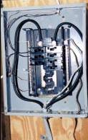
Electrical Safety
Always assume that all overhead wires are energized at lethal voltages.
Never assume that a wire is safe to touch even if it is down or appears to be insulated.
Never touch a fallen overhead power line.
Call the electric utility company to report fallen electrical lines.
1a

Slide 10
Electrical Safety
Stay at least 10 feet (3 meters) away from overhead wires during cleanup and other activities.
If working at heights or handling long objects, survey the area before starting work for the presence of overhead wires.
1a

Slide 11
Electrical Safety
If an overhead wire falls across your vehicle while you are driving, stay inside the vehicle and continue to drive away from the line.
If the engine stalls, do not leave your vehicle. Warn people not to touch the vehicle or the wire.
Call or ask someone to call the local electric utility company and emergency services.
1a

Slide 12
Electrical Safety
Never operate electrical equipment while you are standing in water.
Never repair electrical cords or equipment unless qualified and authorized.
Have a qualified electrician inspect electrical equipment that has gotten wet before energizing it.
1a

Slide 13
Electrical Safety
If working in damp locations, inspect electric cords and equipment to ensure that they are in good condition and free of defects, and use a ground-fault circuit interrupter (GFCI).
Always use caution when working near electricity.
1a

Slide 14
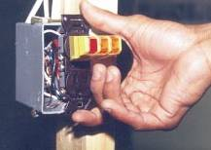
Electrical Safety
Exposed parts that are not locked/tagged are considered to be energized exposed parts
Don’t work on or near exposed electrical parts unless:
the part is de-energized
the part is locked/tagged out
the part is tested to ensure it is de-energized
1b

Slide 15
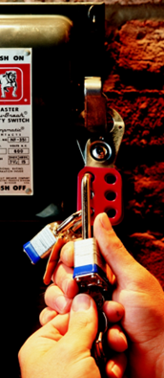
Electrical Safety
Lockout/tagout must be performed by a qualified person or by an authorized person supervised by a qualified electrician
When working on the ground in the vicinity of unguarded, energized overhead lines 50 kv or less to ground:
keep conductive objects at least 10 feet away
2a

Slide 16
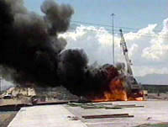
Electrical Safety
Employees standing on the ground must avoid contact with any vehicles, mechanical equipment, or parts under energized lines unless:
Employee is wearing the proper electrical PPE; or
Equipment/vehicle is located so that no uninsulated part can provide a conductive path to employees
4d

Slide 17
Electrical Safety
Do not stand near the grounding location for intentionally grounded equipment or vehicles.
If contact with overhead wires is possible, use insulation and barriers to protect employees from the grounding area
Portable ladders must have nonconductive side rails when used near energized parts
4e

Slide 18
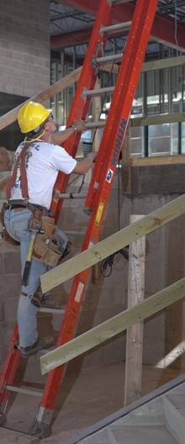
Electrical Safety
If conductive jewelry and clothing are not removed, they must be covered so they are no longer conductive
Use appropriate protective equipment in areas where there are potential electrical hazards
Inspect protective equipment to ensure reliability
If water or fluid has come into contact with electrical panels and the plant trips, the panel must be inspected by a qualified electrician before energizing
5a

Slide 19
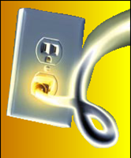
Electrical Safety
Don’t raise or lower equipment by its cord
Don’t unplug the equipment by pulling on its cord
Don’t staple or fasten the cord so as to damage the outer jacket
Inspect equipment for internal defects, as indicated by pinched or crushed outer jackets
Perform inspections prior to beginning any electrical work
Never remove the cord’s grounding pin
Remove defective equipment from service
7a

Slide 20
Electrical Safety
Electrical equipment and cords to be used near water must be approved for this use.
Never use the following to open or close electrical circuits:
Fuses
Terminal lugs
Cable connectors
Cable splice connections
7f

Slide 21
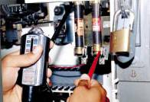
Electrical Safety
Circuit breakers and load rated switches
Don’t manually re-energize a circuit without first determining if the equipment and circuit can be safely energized
Repeatedly closing a circuit breaker or replacing a fuse is not a safe practice
8b

