Slide 1
Back Safety Plan
Back disorders can develop gradually as a result of micro-trauma brought about by repetitive activity over time or can be the product of a single traumatic event.
Because of the slow and progressive onset of this internal injury, the condition is often ignored until the symptoms become acute, often resulting in disabling injury.

Slide 2
Back Safety Plan
Acute back injuries can be the immediate result of improper lifting techniques and/or lifting loads that are too heavy for the back to support.
While the acute injury may seem to be caused by a single well-defined incident, the real cause is often a combined interaction of the observed stressor coupled with years of weakening of the musculoskeletal support mechanism by repetitive micro-trauma.

Slide 3
Back Disorders
Back disorders result from exceeding the capability of the muscles, tendons, discs, or the cumulative effect of several contributors.
Reaching while lifting.
Poor posture--how one sits or stands.
Stressful living and working activities--staying in one position for too long.
Bad body mechanics--how one lifts, pushes, pulls, or carries objects.

Slide 4
Back Disorders
Poor physical condition-losing the strength and endurance to perform physical tasks without strain.
Poor design of job or work station.
Repetitive lifting of awkward items, equipment, or (in health-care facilities) patients.
Twisting while lifting.
Bending while lifting.
Maintaining bent postures.

Slide 5
Back Disorders
Heavy lifting.
Fatigue.
Poor footing such as slippery floors, or constrained posture.
Lifting with forceful movement.
Vibration, such as with lift truck drivers, delivery drivers, etc.

Slide 6
Prevention and Control
Engineering Controls
Alter the task to eliminate the hazardous motion and/or change the position of the object in relation to the employee's body -- such as adjusting the height of a pallet or shelf.
High-strength push-pull requirements are undesirable, but pushing is better than pulling.
Material handling equipment should be easy to move, with handles that can be easily grasped in an upright posture.

Slide 7
Prevention and Control
Repetitive or sustained twisting, stretching, or leaning to one side are undesirable. Corrections could include repositioning bins and moving employees closer to parts and conveyors.
Store heavy objects at waist level.
Provide lift-assist devices, and lift tables.

Slide 8
Prevention and Control
Controls and Work Practices
Engineering controls are preferred.
Worker training and education:
Training should include general principles of ergonomics, recognition of hazards and injuries, procedures for reporting hazardous conditions, and methods and procedures for early reporting of injuries. Additionally, job specific training should be given on safe work practices, hazards, and controls.

Slide 9
Prevention and Control
Other
Standing for extended periods places excessive stress on the back and legs. Solutions include a footrest or rail, resilient floor mats, height-adjustable chairs or stools, and opportunities for the employee to change position.
Where employees are seated the chairs or stools must be properly chosen.
Proper adjustable lumbar support may be provided.
Static seated postures with bending or reaching should be avoided.

Slide 10
Basic Rules of Lifting
Size up the load before you lift
Bend your knees
Center yourself over the load
Get a good hand hold
Lift straight up – let your legs do the work
Never twist or turn
1a

Slide 11
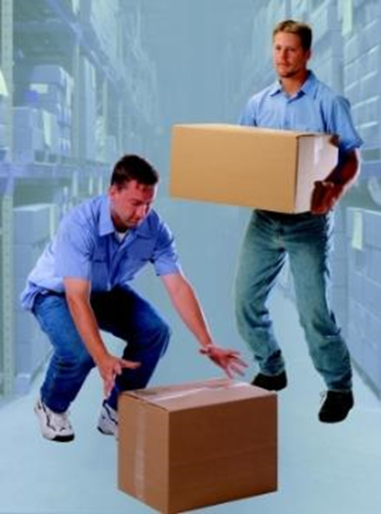
Basic Rules of Lifting
Lift straight up
Follow lifting weight restrictions
Keep back as straight as possible
Test the weight by carefully pushing it, or lifting one corner
Get a good grip of the load
4a

Slide 12
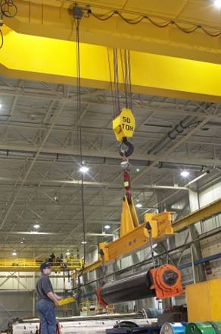
Basic Rules of Lifting
Get help if load is too heavy or too long
lift at the same time to keep load balanced
Split into several loads if possible
Use mechanical equipment
if load is too heavy
Forklift, hoist or dollies
6c

Slide 13
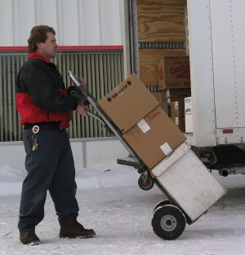
Basic Rules of Lifting
Pushing a load is easier on the back
Pushing a load is easier to control
Always push a cart or dolly
Have a clear path
8a

Slide 14
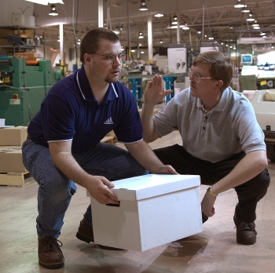
Basic Rules of Lifting
When lowering the load:
Bend the knees
Slowly lower it;
do not drop the load
Avoid sudden movements
Bend knees to let leg muscles support the weight
Lower the load at the same time if working with a partner
7b

