Slide 1
Forklift Training
Operators must be trained and evaluated in a regular bases
Only drive the types of forklifts on which you have been trained
1a

Slide 2
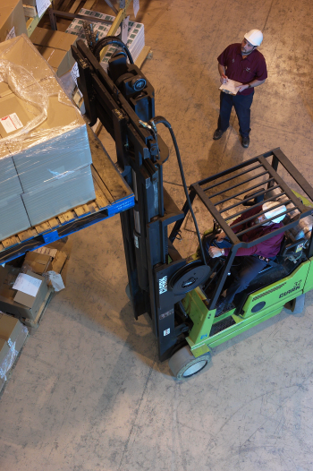
Forklift rules
Don’t stand or pass under raised forks
Use safety platform to lift people
Only handle stable loads within forklift’s rated capacity
Look in direction of travel
Only used approved forklifts for hazardous locations
Allow no riders
2a

Slide 3
Forklift Safety Rules
Don’t drive up to anyone in front of a fixed object
Keep arms, legs in forklift
Keep the load close to ground
Obey speed limits
Slow down and sound horn at intersections
Maintain safe following distance
No stunt driving or horse play
Secure truck trailers before entering
Lower forks, neutralize controls, shutoff engine and set brakes when forklift is unattended
When driving behind forklift stay 3 forklift lengths behind
2c

Slide 4
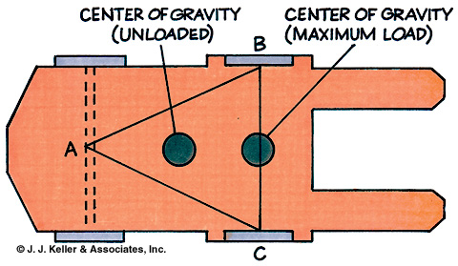
Forklifts vs. automobiles
Rear-wheel steering makes back end swing wide during a turn
Different centers of gravity
Different controls
Heavy loads
Cage / roof to protect from falling objects
Gasoline, LP gas, propane, battery, hydrogen
6a

Slide 5
Picking up a Load
Make sure load is stable
Make sure load is within forklift’s carrying capacity
CSP’s forklift has a capacity of 4500lbs/2040kg
Place forks under load as far as possible
While driving tilt forks back to help stabilize the load.

Slide 6
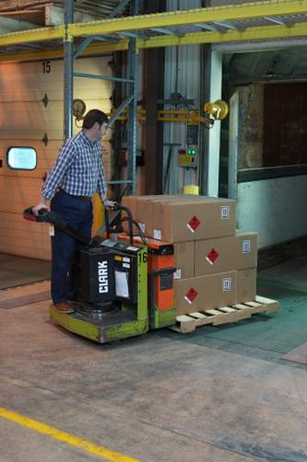
Steering and maneuvering
Rear-end steering
No standard steering wheel
Often drive in reverse
Slow down on wet and oily surfaces, at cross aisles, and when making turns.
9a

Slide 7
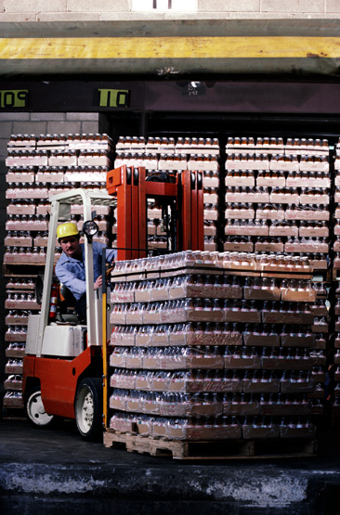
Operator visibility
Loads can restrict vision
Drive in reverse when vision is obscured
Look in the direction of travel
Check blind spots
10a

Slide 8
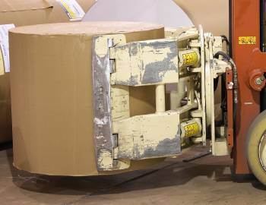
Forks
Additions/modifications may affect stability, safe operation
Attachments can restrict/limit operation
11a

Slide 9
Vehicle stability
Center of gravity shifts as load is raised forklift is less stable with raised load
During a tip-over stay with vehicle, lean away from direction of fall
Don’t jump down as forklift tips
The largest cause of fatal or serious forklift accident is vehicle tip-overs

Slide 10
Inspection and maintenance
Each shift must perform safety checks
Report damage, defects, unusual conditions to maintenance and management
Remove unsafe forklift from service
Reasons to remove forklift from service
Leaky fuel system
Sparks or signs of fire
Overheated parts
Fork controls not functioning
14a

Slide 11
Fueling/charging of batteries
Exposes workers to hazardous chemicals, electrical hazards
No smoking, flames, sparks, arcs
Keep tools, metallic objects away from uncovered batteries
15a

Slide 12
Parking
Never park on an incline
Never park at the edge of a platform
When done using the forklift
Park in designated area or in a space that does not obstruct aisles, stairs, or emergency equipment and access.
Lower forks
Put into neutral
Set parking brake
Turn off forklift
Note: the lights run off of battery power and will not turn off when forklift is turned off.
17a

Slide 13
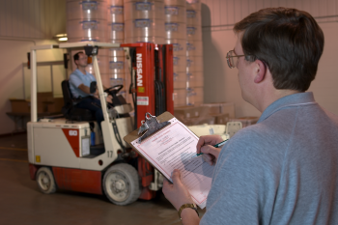
Retraining/re-evaluation
Triggered by certain events
I.E. Accident or Injury
Evaluate at least every 3 years
18a

