Slide 1
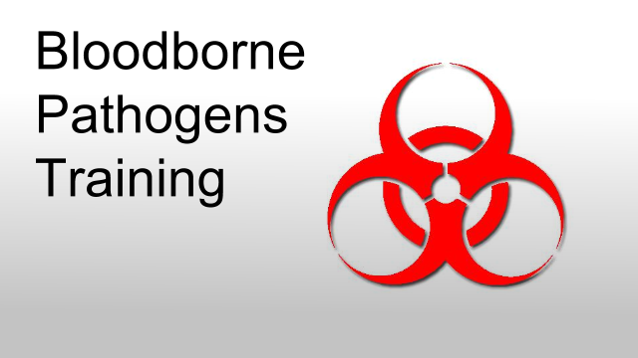
CSP Denver – 02/09/2015

Slide 2
What are Bloodborne Pathogens?
Bloodborne pathogens are microorganisms in human blood that can cause disease in humans. Examples are hepatitis B virus (HBV), human immunodeficiency virus (HIV), malaria, syphilis, and brucellosis.
Even though HIV is better known, the Hepatitis B virus (HBV) is both more common and easily spread. HBV causes an infection of the liver, which can lead to liver disease, cancer, or death. Symptoms can be hard to discover, and may not appear at all, but the infected person can still spread the disease.

Slide 3
OSHA’s definition of the Bloodborne Pathogen (BBP)
Under the OSHA rule, blood means human blood, blood products, or blood components. Other potentially infectious materials include human body fluids such as semen, vag­inal secretions; cerebrospinal, synovial, pleural, pericardial, peritoneal, and amniotic fluids; saliva in dental procedures; any body fluids visibly contaminated with blood; unfixed human tissues or organs; and all body fluids in situations where it is difficult or impossible to differentiate between body fluids.

Slide 4
Routes of exposure to BBP(not limited)
Parenteral - A piercing of membranes in the nose or mouth, or of the skin barrier by means of a puncture by a sharp item, human bite, cut, or abrasion.
Exposure Incident - A specific eye, mouth, other mucous membrane, non-intact skin, or parenteral contact with blood or other potentially infectious materials that results from the performance of an employee’s duties.
Occupational Exposure - Reasonably anticipated skin, eye, mucous membrane, or parenteral contact with blood or other potentially infectious materials that may result from the performance of an employee’s duties.
Source individual - Any Patient whose blood or body fluids are the source of an exposure incident to the employee.

Slide 5
How can I protect myself?
We have to assume that blood, certain bodily fluids, tissue, cultures, or organs are contami­nated. You must protect yourself from contact with these substances, and properly dispose of any potentially contaminated items so as to reduce the risk of exposure to others.
(In CSP BloodBorne Pathogen containment Kit is located in Control room )
In addition to engineering controls and work practices controls your employer may implement, personal protective equipment may also be required.

Slide 6
How can I protect myself?
Precautions include:
Handwashing.
Using personal protective equipment (gloves, masks, face shields, goggles, gowns, and so on).
Housekeeping issues include:
Periodic environmental disinfection. Including, work surfaces contaminated with blood or OPIMs (Other Potentially Infectious Materials) are cleaned and decontaminated.
Mechanical means are used to pick up contaminated broken glass and proper disposal of contaminated materials and sharps.
Vaccination against HBV:
Vaccination is the best protection against hepatitis B infection.
For full effect, three shots of vaccine are needed to give long-term protection

Slide 7
What must my employer do?
Your employer is required to:
Develop a written exposure control plan, and review it with you.
(Refer-CSP Safety & Environmental manual- topic 18. for exposure control plan)
Exposure plan should include:
Job classification that has occupational exposure to blood or OPIM
Use and sign to communicate the hazards
Provision for proper use of PPE.

Slide 8
Hepatitis B Vaccination
The Hepatitis B vaccination shall be made available to the employee upon receipt of training and within 10 working days of the employee’s initial work assignment.
All employees who decline the Hepatitis B vaccination offered shall sign a “Hepatitis B Vaccine Declination Form BP-1- CSP Safety and Environmental Manual”.
If an employee initially declines Hepatitis B vaccination but at a later date while still covered under the standard decides to accept the vaccination, the vaccination shall then be made available.

Slide 9
HEPATITIS B VACCINE AND POST EXPOSURE EVALUATION AND FOLLOW-UP
The Company shall make available a confidential medical evaluation and follow-up to any employee who reports an exposure incident. This report can be made on the “Post Exposure Evaluation Form BP-5”. It will include the following information.
Documentation of routes of exposure.
A description of the circumstance surrounding the exposure.
Identification and documentation of the source individual, unless it is established that identification is not feasible or is prohibited by state or local law.

Slide 10
“Good Samaritan Acts”
When an employee not trained in first aid assists another employee who is injured, he/she would be covered under the “Good Samaritan Acts”. This would not be classified as an assigned duty and the employee is not expected or required to render assistance.
These individuals are exempts from BBP training.

Slide 11
What is occupational exposure?
Occupational exposure means a "reasonably anticipated skin, eye, mucous membrane, or parenteral contact with blood or other potentially infectious materials that may result from the performance of the employee’s duties."

Slide 12
Engineering and Work Practice Controls
Engineering Controls means controls (that isolate or remove the bloodborne pathogens hazard from the workplace. (example: procuring and using puncture resistant disposal container for bio hazard waste)
Work Practice Controls means controls that reduce the likelihood of exposure by altering the manner in which a task is performed (e.g., prohibiting to eat or drink in laboratory).

Slide 13
Universal Precautions
Universal precautions is the term for infection control measures that all those who are or may be exposed to infectious disease should take.
It is an approach to infection control where all human blood and certain human body fluids are treated as if they were known to be infectious for bloodborne pathogens.

Slide 14
Universal Precautions
Follow these precautions when working with human blood and other potentially infectious materials (OPIMs):
Wear appropriate personal protective equipment (PPE) and must be used properly to be effective.
Dispose of sharps objects properly.
(Blood borne pathogen kit in CSP is located in control room, on top of first aid box.)
Properly label and enclose any material contaminated with blood or OPIMs in leak proof red bags or containers.
Wash your hands after handling contaminated material (even though you were wearing PPE).
Report any exposure incident to your employer. An exposure incident is any specific eye, mouth, other mucous membrane, non-intact skin, or parenteral contact with blood or OPIM resulting from the performance of an employee's duties.

Slide 15
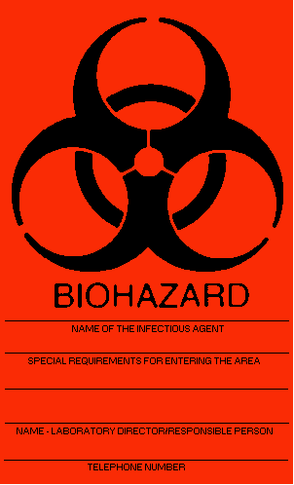
Universal Biological hazards symbol
The Facility Manager shall ensure that biohazard labels shall be affixed to containers of regulated waste, refrigerators and freezers containing blood or other potentially infectious materials, and other containers used to store, transport or ship blood or other potentially infectious materials.
Three signals can alert you to the presence of a biohazard or biohazardous waste:
The word “biohazard”
The biohazard symbol, or
The fluorescent orange or orange-red color-coding

