Slide 1
CERCLA, Spill Management and Storm Water Pollution Prevention

Slide 2
CERCLA & Spill Management
The Comprehensive Environmental Response, Compensation, and Liability Act (CERCLA), commonly known as Superfund, was enacted by Congress on December 11, 1980.
The law created a tax on the chemical and petroleum industries and provided Federal authority to respond directly to releases or threatened releases of hazardous substances that may endanger public health or the environment.

Slide 3
Spill Management
Tax collected went to a trust fund for cleaning up abandoned or uncontrolled hazardous waste sites. CERCLA:
Established prohibitions and requirements concerning closed and abandoned hazardous waste sites.
Provided for liability of persons responsible for releases of hazardous waste.
CERCLA also enabled the revision of the National Contingency Plan (NCP). The NCP provided the guidelines and procedures needed to respond to releases and threatened releases of hazardous substances, pollutants, or contaminants.

Slide 4
Spill Management
This document describes the standard procedure to contain spills by using the universal spill kits available in the plant, in addition to reporting procedures.
The most probably liquid leaks in the plant consist of:
Hypochlorite
Caustic Soda
Hydrochloric Acid
Additives

Slide 5
Spill Management
Reportable quantities
The reportable quantities (RQ) for CSP’s products and materials are as follows:
 |  | Reportable Quantity
 |  | CERCLA | Typical CSP
 |  | 100 % (Lbs) | Concentration | gal
 | Caustic Soda | 1000 | 50% | 156
SARA 313 | Chlorine | 10
 | Diesel Fuel | 1680 |  | 210
SARA 313 | Ethylene Glycol (antifreeze) Additive | 5000
SARA 313 | Hydrochloric Acid | 5000 | 35% | 1460
 | Sodium Hypochlorite | 100 | 10% | 103
 |  |  | 12.50% | 80

Slide 6
Spill Management
REPORTING:
What DOES NOT NEED to be reported
The following releases DO NOT need to be reported
Releases below the RQ which results in exposure to persons solely within the workplace;
Release in compliance with applicable categorical pretreatment standards and local limits.
Releases into a Publicly Owned Treatment Works (POTW) with an approved local pretreatment program or a State-administered local program.

Slide 7
Spill Management
REPORTING
Section 103 of CERCLA requires the "person in charge" of a facility, as soon as he or she has knowledge of a release of a hazardous substance in an amount equal to or greater than an RQ, to report the release immediately to the National Reporting Centre (NRC).
The NRC number is 1-800-424-8802

Slide 8
Spill Management
REPORTING
The CSP’s reporting process will proceed as follows:
Lead operator reports immediately to Plant Manager
Plant Manager reports to NRC and headquarters
In the event that Plant manager is out of reach within 1/2 hour, lead operator reports directly to NRC

Slide 9
Spill Management
REPORTING
The following information must be provided when reporting
It is found under “Chemical Spill Emergencies” in the Emergency Action Plan Binder
Forms are found in section “E1” of the Safety and Environmental Manual.
Name, address, and telephone number of the person reporting and the responsible party;
Specific location of the incident;
Date and time the incident occurred or was discovered;
Name of the chemical/material released;
Source and cause of the release;
Total quantity discharged;
Medium into which the substance was discharged;

Slide 10
Spill Management
Information that must be provided:
Amount spilled into water;
Weather conditions;
Name of the carrier or vessel, the railcar/truck number, or other identifying information;
Number and type of injuries or fatalities;
Whether an evacuation has occurred;
Estimation of the dollar amount of property damage;
Description of current and future cleanup actions; and
Other agencies notified or about to be notified.

Slide 11
CERCLA & Spill Management
Spill Kits
CSP uses a Universal Spill Kit with the following specs:
Volume absorbed: 41 gal
Standards: OSHA, EPA, DOT
Fluids absorbed: Universal / Maintenance
Container size: 65 gal
Each kit includes:
1 - 65-Gallon Salvage Drum (Recyclable)
1 - 1-Gallon Jug ENSORB
50 - Universal Pads
8 - Universal Large Socks

Slide 12
Spill Management
Spill Kits
Contents:
12 - Universal Small Socks 1 - package Wipes 4 - Disposal Bags and Ties 2 - Pair Nitrile Gloves 2 - Pair Goggles 1 - Emergency Response Guide 1 - Instruction Sheet and MSDS
The spill kits are compatible with all chemicals currently at CSP

Slide 13
Spill Management
The spill kits are located throughout the plant in the following locations:
Electrolyser area
Hypo fill area (2)
Acid storage area
Warehouse
Monitoring
The status of spill kits is monitored via visual inspection in a monthly bases.

Slide 14
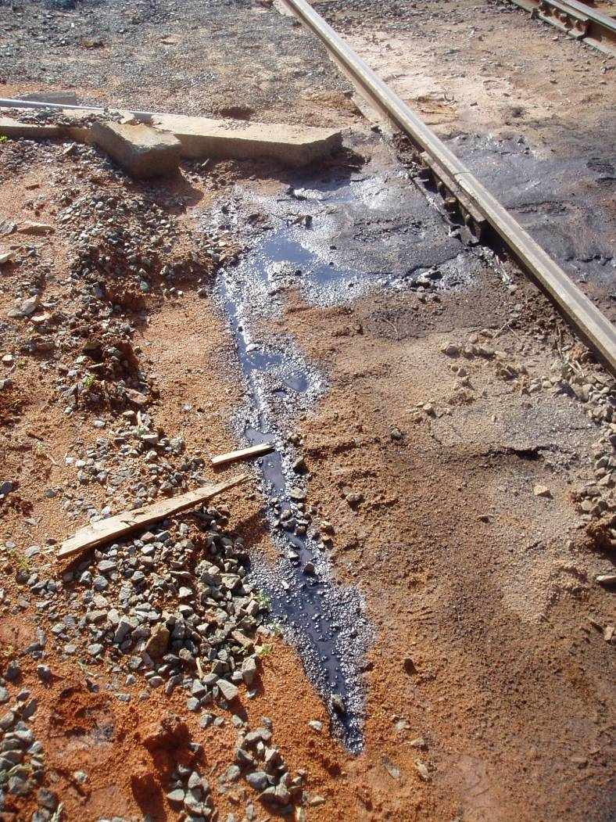
Storm Water Pollution Prevention
Storm water discharges are often the main cause of ocean, river, lakes pollution in the U.S.
It is estimated that storm-water contributes as much as 80% to water pollution in the U.S.
One quarter of oil can contaminate 250,000 gallons of water
This training helps improve compliance with the Clean Water ACT
Yearly employee training is mandatory

Slide 15
Storm Water Pollution Prevention
What is Storm Water?
Rain, Snow or Ice Melt
Water does not seep into the ground. It is channeled by storm sewers
The final destination of storm water is Streams, Rivers, Lakes, Oceans

Slide 16
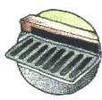
Storm Water Pollution Prevention
What causes storm water pollution?
Rain, Snow or Ice Melt picks up pollution like trash, oil, chemicals, and sediments.
STORM DRAINS ARE NOT CONNECTED TO A TREATMENT PLANT!
Different form Sanitary sewers
Water flowing in Storm Sewers is untreated

Slide 17
Storm Water Pollution Prevention
FEDERAL REGULATIONS
Section 402(p) establishes the framework for regulating storm-water under the National Pollutant Discharge Elimination System Program (NDPES)
40CFR Parts 122-125 –NPDES regulations
40CFR Part 122.26 Storm Water Discharges
40CFR Subchapter: national Effluent Limitations Guidelines

Slide 18
Storm Water Pollution Prevention
CSP falls within the category defined as :
Manufacturing: “Source of storm water discharge associated with industrial activity”
CSP is located in a municipality, Denver, that requires an NPDES permit.
Therefore, CSP requires an NPDES permit in compliance with Denver’s permit.

Slide 19
Storm Water Pollution Prevention
What Do Regulations Mean?
Only Rain Water in the Drain
No Oils or Chemicals
No Concrete or Construction Waste
No Septic Waste
No Sediments
ONLY RAIN WATER IN THE DRAIN!

Slide 20
Storm Water Pollution Prevention
Pollution Prevention Strategies
Best management Practices
Source Control
Treatment Control

Slide 21
Storm Water Pollution Prevention
Best management Practices
Prevent spill from entering drains
Routinely clean storm drains
Keep dumpsters closed
Cover waste storage areas
Control litter by sweeping and picking up
Transfer chemicals in designated areas only
Use secondary containments for storage and bulk unloading / loading
Do not over use pesticides and fertilizers
Train Employees

Slide 22
Storm Water Pollution Prevention
Source Controls
Minimize impervious area
Filter strips and Swales
Use oil – water separators
Treatment Controls
Designed to remove pollutants from storm-water run-off
Extended detention
Retention or wet ponds
Wetlands
Filters

Slide 23
Storm Water Pollution Prevention
Enforcement: CSP must:
Be familiar with Storm Water Management Program (SWMP)
Maintain Housekeeping
Complete quarterly inspections
Complete annual report and audit as required by the SWMP

Slide 24
Please refer to CSP Safety and environmental manual for detailed and updated information
and forms for “ CSP CERLA program”. Physical copies in control room, front office and electronic copy in drop box.

